Slide 1
Real Time Operating Systems & Real-Time Linux
Zonghua Gu

Slide 2
What is a Real-Time System?
A real-time system is one in which the correctness of the system depends not only on the logical result of computation, but also on the time at which the results are generated
J. Stankovic, 1988
Not necessarily “real-fast”!
Predictability is the key
There was a man who drowned crossing a stream with an average depth of six inches
J. Stankovic

Slide 3
Hard or Soft?
Hard real-time systems cannot afford to miss any deadlines
Engine control
X-by-wire
VxWorks, OSEKWorks, QNX
Soft real-time systems can afford occasional deadline misses
In-vehicle multimedia
Windows CE
Non-real-time systems
Do they really exist?

Slide 4
Embedded Systems
Systems with a small computer embedded within it
The embedded computer forms the brain of the system
Mechanical devices form the eyes (sensors) and muscles (actuators)

Slide 5

Example RTE Systems
military systems
spacecraft
factory automation
home appliances
office equipment
medical instruments

Slide 6
Categories of Embedded Systems
Stand-alone Embedded Systems
Work in a stand-alone mode taking input and producing the desired output
Networked/Distributed Embedded Systems
Embedded systems with network interface and accessible through the network.
Interacting set of embedded systems
E.g., sensor networks, web camera based monitoring systems
Mobile Devices
Mobile phones, PDAs

Slide 7
Question
Are there real-time systems that are not embedded?
Air traffic control systems
Stock brokerage systems
Are there embedded systems that are not real-time?
Almost all systems have some sort of soft real-time constraints
Imagine your word processor taking 2 minutes to respond to you commands

Slide 8
Characteristics of RTE Systems
Power Constraints
Limited power source like a battery
Minimize power demand by using less or low power hardware components
Cost
Especially a constraint on mass produced consumer appliances like mobile phones, cars…
Sometimes even a $0.10 decrease may lead to large savings
Reliability
Should function for extremely long periods of time without developing faults
Cannot reboot a car in motion, or a spacecraft in flight!

Slide 9
Characteristics of RTE Systems
Performance
Especially important in real-time systems
Response within the deadline
Memory Size Limitations
Important consideration while designing software
Cannot have a 1GB Operating System!
No hard disk!
Software Upgrade
Software should be upgradable, cannot burn everything into ROM
Remote uploading of software updates

Slide 10
Characteristics of RTE Systems
Size
A mobile phone the size of a brick will not be popular!
Reducing size may impose additional limitations on power supply, heat dissipation
Limited User Interface
May have very limited input/output interfaces
Small keypad with few buttons for input
Perhaps a two line LCD display
Headless systems with no UI?
Put a HTTP server on the machine and access it remotely?

Slide 11
Challenges in RTE System Design
Limited OS support for programming
Development has to be done on a separate development workstation
Embedded OS is part of application code
No user mode/kernel mode separation
Limited secondary storage
Only limited non-volatile memory (ROM, Flash) available
Cannot support virtual memory
Limited RAM
Limitations on the code size
Memory leaks can be fatal, eventually!

Slide 12
Challenges in RTE System Design
Limited processing power
Low speed (10-100 MHz) microprocessors
Efficient code and simple algorithms required
Interaction with hardware
Cannot completely hide the hardware complexity
May have to directly interact with hardware
Absence of standard I/O devices
Debugging may have to be done remotely

Slide 13
What is Real Time ?
“ Real time in operating systems: The ability of the operating system to provide a required level of service in a bounded response time.”
- POSIX Standard 1003.1

Slide 14
Real-Time in Handheld & Embedded Systems
Cost / Performance / Power / Weight Compromise
Competitive, High-Volume, Low-margin Markets
Maximum Feature-set, Add-ons, Responsive UI feel
Device specs: minimal CPU & Memory & Battery Powered
Real-time Requirements will never be alleviated by Improvements in Hardware Performance / Efficiency
Notes:
Software utilizing latest hardware technologies easily keep up with, and usually out-paces, advances in hardware technology
If you don't believe that, go shopping (for a mobile phone)

Slide 15
Soft Real-Time Systems
In a soft real-time system, it is considered undesirable, but not catastrophic, if deadlines are occasionally missed.
Also known as “best-effort” systems
Examples:
multimedia transmission and reception,
networking, telecom (cellular) networks,
web servers
computer games.

Slide 16
Hard Real-Time Systems
A hard real-time system has time-critical deadlines that must be met; otherwise a catastrophic system failure can occur.
Requires formal verification/guarantees of being to always meet its hard deadlines
Examples:
air traffic control
vehicle control subsystems
nuclear power plant control
Notes:
Absolutely, positively, first time every time
(except for fatal errors).

Slide 17
Components of an RTOS
Task (process or thread) management
Scheduler
Synchronization mechanism (semaphores, monitors)
Memory management
Interrupt service mechanism
I/O management
Development Environments
Communication subsystems
Board Support Packages (BSP)
Notes:
Interprocess communication (IPC)

Slide 18
Real-Time Linux & PREEMPT_RT

Slide 19
Outline
Real-Time Linux Background
Real-Time Linux Evolution
Real-Time Linux Enablers
Real-Time Inhibitors
Interrupt Latency
Kernel Locking
Legacy Locking
Real-Time Kernel
Interrupt Handlers, PI Mutex
Performance / Benchmarks
Acceptance
Virtualization

Slide 20
Linux in Real-Time Systems
UNIX systems (and Linux) are historically not Real-Time OS
UNIX-legacy Operating Systems were designed with operating principles focused on throughput and progress
System resources must be shared fairly between users
Fairness, progress and resource-sharing conflict with the requirements of time-critical applications
Notes:
Not because of the Kernel’s Real-Time Performance!
UNIX-legacy Operating Systems were designed with operating principles focused on throughput and progress
User tasks should not stall under heavy load
System resources must be shared fairly between users
Fairness, progress and resource-sharing conflict with the requirements of time-critical applications
VIP vs. General Admission
User tasks should not stall under heavy load
Linux has lagged many commercial Unix's in Real-Time performance-enhancement and Real-Time capabilities

Slide 21
Two Approaches
Dual-kernel approach
Keep the regular Linux kernel intact
Insert a small micro-kernel beneath regular Linux kernel
Linux kernel handles non-real-time tasks/micro-kernel handles real-time tasks
e.g. RT-Linux,. RTAI, Xenomai
Enhancing Linux kernel
e.g. PREEMPT_RT patch, MontaVista Linux, TimeSys Linux,

Slide 22
RT-Linux
Available as a patch to the regular Linux kernel
Provides an RT API for developers
Runs a Linux kernel as an idle thread (lowest priority) of the real-time kernel.
RT kernel and RT applications are kept as simple as possible and non-real-time applications (GUIs, file systems) are handled by standard Linux kernel.
Notes:
Predictable delays.
By its small size and limited operations.
Finer timer resolution.

Slide 23
RTLinux ( Contd )
Real time threads and interrupt handlers never delayed by non-real-time threads
Micro-kernel:
Very small and fast, this does not cause big delays.
Supports EDF (Earliest Deadline First) and Fixed-Priority schedulers
Notes:
FIFO.
Used to pass information between real-time process and ordinary Linux process.
Designed to never block the real-time task.

Slide 24
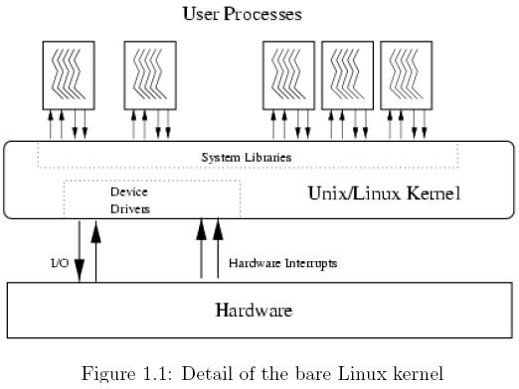
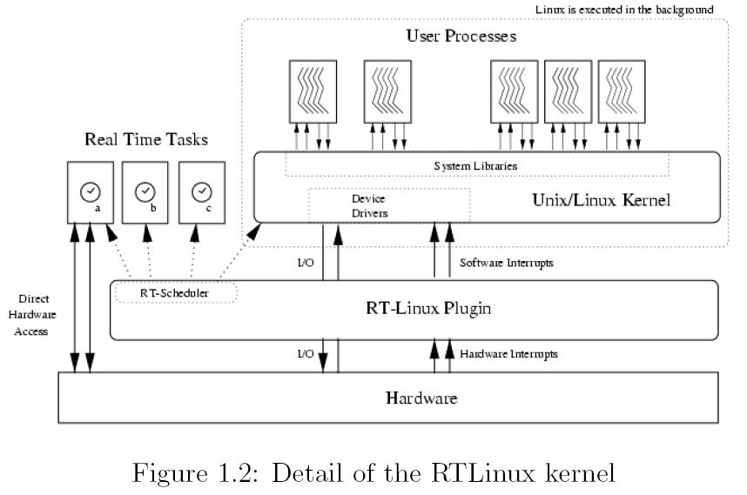
Linux vs RT-Linux

Slide 25
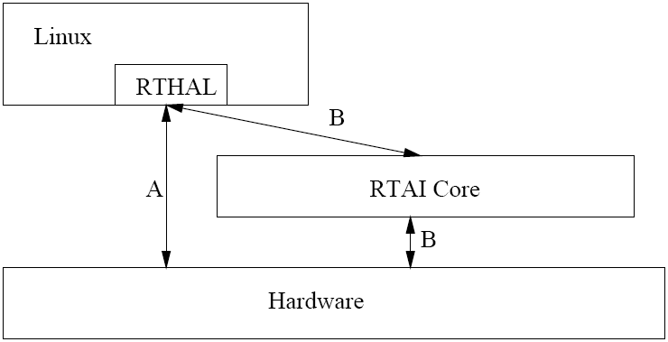
RTAI (Real Time Application Interface)
A patch to the Linux kernel which introduces a hardware abstraction layer
Linux kernel is run as a background task running when no real time task is running.
Linux application is able to execute without any modification
Notes:
A broad variety of services which make realtime programmers' lifes easier
RTAI provides deterministic response to interrupts, POSIX compliant and native RTAI realtime tasks.
Hard real-time extension to the Linux kernel
Consists of:
1 I/F to Linux HW Management (HAL): basically a data structure.
3 basic components (dispatcher, scheduler, fifo's).
1 I/F (set of functions) used in user tasks to initialize and start the components.
From a Linux point of view these entities populate modules.

Slide 26
RTAI ( Contd )
Real time scheduler module
Task functions
Timing functions
Semaphore functions
Mailbox functions
Intertask communication functions
Fifo services
Shared memory
Posix pthread and pqueue(msg queue)
Notes:
RTAI is very much module oriented
RTAI provides better real-time support than RTLinux
soft real-time in user space along with hard real-time in kernel space
excellent performance in terms of low jitter and low latency
better C++ support and more complete feature set
availability of LXRT which allows user space applications in kernel space

Slide 27
Real-Time and Linux Kernel Evolution
Gradual Kernel Optimizations over Time
SMP Critical sections (Linux 2.x)
Low-Latency Patches (Linux 2.2)
Preemption Points / Kernel Tuning (Linux 2.2 / 2.4)
Preemptible Kernel Patches (Linux 2.4)
Fixed-time “O(1)” Scheduler (Linux 2.6)
Voluntary Preemption (Linux 2.6)
Notes:
What Happened?
In 2003-04 Linux 2.6 RT Technology Regressed

Slide 28
Real-Time Inhibitor: Critical Section Locking
Linux 2.6 Kernel Critical Sections are Non-Preemptible
Critical sections protect shared resources, e.g. hardware registers, I/O ports, and data in RAM
Critical sections must be locked and unlocked
Locked critical sections are not preemptible
Linux 2.6 Kernel has 11,000 critical sections
Exhaustive Kernel testing to identify worst-case code paths
Labor-intensive cleanup of critical sections
Worst-case critical section length after cleanup still not acceptable
No control over 3rd party drivers
Notes:
Critical sections are shared by Processes, Interrupts and CPUs.
Effective protection is provided by the Spin-Lock Subsystem
Maintenance, community education, policing / regression testing

Slide 29
Real-Time Inhibitor: Interrupt Handlers
Linux 2.6 Kernel: Unbounded IRQ subsystem latencies
Interrupts cannot be preempted
Interrupts always have higher priority than application tasks
Interrupt handlers always preempt application tasks unconditionally
Task latency increases with hardware-interrupt load
Notes:
Unbounded SoftIRQ subsystem (“Bottom Half Processing”)
Activated by HW IRQs (Timers, SCSI, Network)
SoftIRQs re-activate, iterate
Driver-level adaptations
Network Driver NAPI adaption reduces D.o.S. effects of high packet loads

Slide 30
Real-Time Inhibitor: Legacy Locking
Existing Locking Subsystems are not Priority-Aware
System semaphore
No support for priority inheritance
No priority ordering of waiters
Big Kernel Lock (BKL)
Originally non-preemptible, now preemptible using system semaphore
Can be released by blocking tasks, re-acquired upon wake-up
No priority-awareness, or priority inheritance for contending tasks
RCU (Read-Copy-Update) Locks in Network subsystem
Read-optimized cached locking requiring race-free invalidation
Read – Write Locks
Classical blocking / starvation issues with no priority awareness

Slide 31
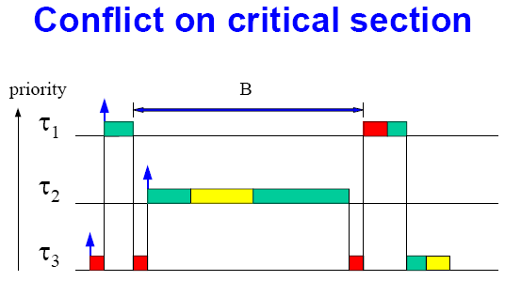
Priority Inversion
Priority inversion:
Tau₁ is delayed by Tau₂ for an unbounded amount of time

Slide 34
The Fully Preemptible Linux Kernel
Dramatic Reduction in 2.6 Preemption Latencies
Multiple Concurrent Tasks in Independent Critical Sections
Generally Fully Preemptible → “No Delays”
Non-preemptible: lowest-level interrupt management
Non-preemptible: Scheduling and context switching code
Notes:
Interrupt off paths and Optimization Flexibility
RT Tasks designed to use Kernel-resources in managed ways can reduce or eliminate Priority-Inheritance delays
Adequate Instrumentation
Latency timing, latency triggers & stack tracing, histograms
Design Flexibility
Provides Full Access to Kernel Resources to RT Tasks
Supports existing driver and application code
User-space Real-Time

Slide 35
Linux Real-Time Technology Overview
Linux 2.6 Kernel Real-Time Technology Enhancements
Preemptible Interrupt Handlers in Thread Context
Integrated Kernel Mutex with Priority Inheritance (PI)
Preemptible PI Mutex protects Kernel Critical Sections
PI Mutex Substituted for Non-Preemptible Kernel (SMP) Locks
Big Kernel Lock (BKL) converted to PI Mutex
Spin-Locks converted to PI Mutex
Read-Write Locks converted to PI Mutex
RCU Preemption Enhancements
High Resolution Timers
Notes:
IRQ-Disable Virtualization for Drivers
IRQ threads disabled without masking hardware
User-Space Mutex
Robustness / Dead-Owner / Priority Queuing

Slide 36
Thread-Context Interrupt Handlers
Real-Time Solution: Interrupts in Thread Context
Demote IRQ Handler Execution to Thread-based function
IRQ Handlers scheduled in bounded-time by O(1) scheduler
Inter-leaving of RT and IRQ tasks
Real-Time tasks can have higher priority than IRQ handlers
Notes:
Incoming IRQ returns immediately
IRQ activates corresponding Handler-thread (wake_up_process)
RT IRQs operate in Vacated IRQ execution-space
RT IRQs do not contend with common IRQs - Runs at IRQ Priority
RT IRQ Latency Predictable
Subject to Minimal Variation
Promoted SoftIRQ Daemon Processes ALL Bottom-half activity
SoftIRQs Preemptible
Functionality of IRQ Handlers does not require IRQ context
no special “IRQ Mode” Instructions
IRQ Thread can have private stack
Default: IRQs run in threads

Slide 37
Thread-Context Interrupt Handlers
Threaded IRQs Pros
RT IRQs do not contend with common IRQs
IRQ Processing does not Interfere with task execution
Flexible priority assignment
can be arranged to emulate hardware-based priorities
Interrupts run fully preemptible
Threaded IRQs Cons
IRQ-Thread Overhead
Scheduler must run to activate IRQ Threads
IRQ Thread Latency
IRQs no longer running at the highest priority
Context-switch required to handle IRQ
Response-Time / Throughput tradeoff

Slide 38
Priority-Inheriting Kernel Mutex
New Synchronization Primitive
Priority Inheritance
Eliminate Priority Inversion delays
Priority-ordered O(1) Wait queues
Constant-time Waiter-list processing
Minimize Task Wake-Up latencies
Notes:
Preemptible alternative to spin-locked / non-preemptible regions
Expands on “Preemptible Kernel” Concept
Spinlock typing preserved (maps spin_lock to RT or non-RT function )
Enabler for User-space Real-Time Condition Variables & Mutexes Fundamental RT Technology
Preprocessor determines static function mapping
Compile-time mapping, based on declared type
#define spin_lock(lock) PICK_OP(raw_spinlock_t, spin, _lock, lock)
PICK_OP #define PICK_OP(type, optype, op, lock) \ do { \ if (TYPE_EQUAL((lock), type)) _raw_##optype##op((type *)(lock)); \ else if (TYPE_EQUAL(lock, spinlock_t)) \ _spin##op((spinlock_t *)(lock)); \ else __bad_spinlock_type(); \ } while (0)
TYPE_EQUAL #define TYPE_EQUAL(lock, type) \ __builtin_types_compatible_p(typeof(lock), type *)
Deadlock Detection
Identify Lock-Ordering errors
Reveal Locking cycles

Slide 39
Real-Time Linux Kernel Evolution
SMP-Oriented Linux Kernel Optimizations
Early Kernel 1.x
No Kernel preemption
SMP Kernel 2.x
No Kernel preemption, “BKL” SMP Lock
SMP Kernel 2.2 - 2.4
No preemption, Spin-locked Critical Sections
“Preempt” Kernel 2.4
Kernel Preemption outside Critical Sections Spin-locked Critical Sections
Current Kernel 2.6
Kernel Preemption outside Critical Sections, Preemptible “BKL”, O(1) Scheduler
“RT-Preempt” Kernel
Kernel Critical sections Preemptible IRQ Subsystem Prioritized and Preemptible Mutex Locks with Priority Inheritance
High-Resolution Timers

Slide 40
Kernel Evolution: Preemptible Code
Kernel 2.0
Kernels
2.2-2.4
Preemptible
Kernel 2.4
Kernel 2.6
Real-Time
Kernel 2.6
Preemptible
Non-Preemptible

Slide 41
Real-Time Linux 2.6 Performance
Real-Time Linux 2.6 Kernel Performance
Enables sub-millisecond control-loop response
Enables Hard Real Time for qualified RT-aware Applications
SMP Kernel Performance
Increased preemption in the Kernel also increases SMP throughput / efficiency
SMP-safe code is by definition preemptible
Any code that allows concurrent execution by multiple CPUs, also allows context switching and therefore preemption
Notes:
Far exceeds most stringent Audio performance requirements

Slide 42
FRD
Fast Real-time Domain
Measurement tool
Thread 1 runs
Thread 2 runs
IRQ handler
Schedules
Thread 1
Thread 1
Schedules
Thread 2
etc
Δt
Δt

Slide 43
Benchmarks
Target machine:
Intel® Celeron® 800 MHz
Workload applied to the target system:
Lmbench
Netperf
Hackbench
Dbench
Video Playback via MPlayer
CPU utilization during test:
100% most of the time
Test Duration:
20 hours

Slide 44
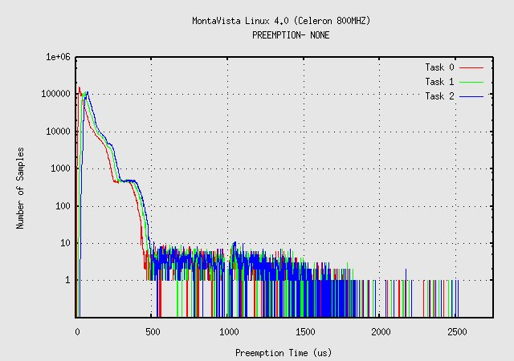
Linux 2.6 Kernel – No Preemption
Line Chart Title
Source:

Slide 45
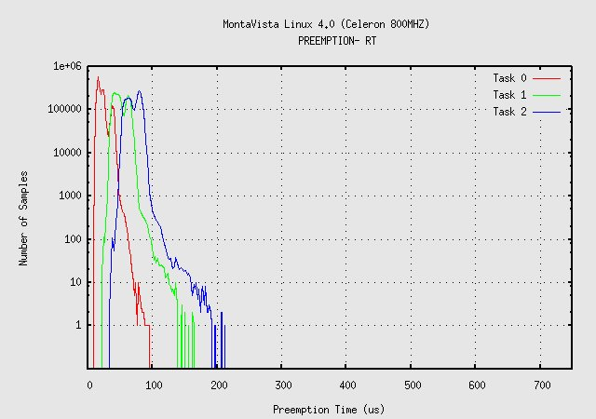
Linux 2.6 Kernel – Real-Time Preemption
Line Chart Title
Source:

Slide 46
Real-Time Response vs. Throughput
Efficiency and Responsiveness are Inversely Related
Real-Time Preemption introduces overheads
Mutex Operations more complex than spinlock operations
Interrupt overhead
Additional Task Switching
Interrupt Preemption → Interrupt throughput reduction
Throughput
High responsiveness

Slide 47
Real-Time and Linux Kernel Evolution
Today
Real–Time Preemption
High Resolution Timers
Future Innovation
RT “awareness” extensions to Power-management subsystem
Quick CPU Power+Freq Ramp for RT Tasks
Power Level Scheduling Classes
Virtualization / Hypervisor support for Real-Time
Notes:
Rate-Monotonic scheduling of RT tasks in independent VMs
Per-VM QoS guarantees
User-Space Robust Mutex

Slide 48
Open Source
Ongoing Real-Time Development
Patch against current Community Kernel (2.6.16)
Maintained by Ingo Molnar from RedHat
Architectures: i386, x86_64, PPC 32/64, Arm
Download from:
http://www.kernel.org/pub/linux/kernel/projects/rt/
Notes:
Contributions from Community

Slide 49
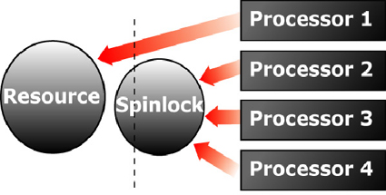
RT Synchronization on Multicore
Muticore processors introduce new issues and challenges to shared data synchronization.
Spinlocks are typically used to protect shared resource

Slide 50
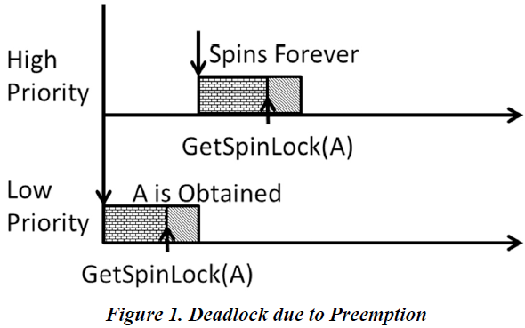
Deadlock on a Uni-Processor
A lower priority task holding a resource protected by SpinlockType A gets preempted by a higher priority task that later tries to acquire the same SpinlockType A
One solution: protect a TASK by wrapping the spinlock with a SuspendAllInterrupts () call so that the task cannot be preempted.

Slide 51
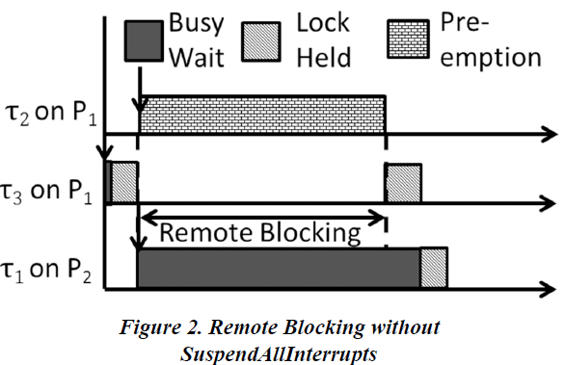
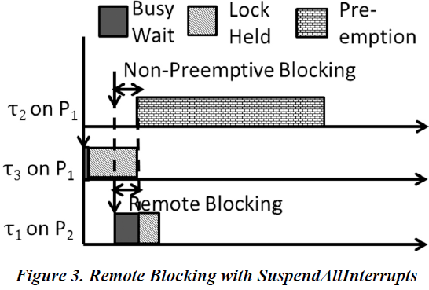
Remote Blocking on Multicore
Remote blocking is defined as the duration for which a task waits for a shared resource to be released on a remote core.
Three tasks τ1, τ2, and τ3 in decreasing order of task priorities. Let tasks τ2 and τ3 be assigned to core P1, and task τ1, be assigned to core P2. Tasks τ1, and τ3 share a resource R protected by a SpinlockType S.
Left: τ3 acquires the resource R and gets preempted by task τ2 on core P1 before releasing R. In this case, task τ1 executing on core P2 might try to acquire the resource R and get blocked indirectly by τ2
Right: use of SuspendAllInterrupts () leads to a significant reduction in the remote blocking suffered by τ1 as

Slide 52
Commercial RTOSes
LynxOS
QNX/Neutrino
VRTX
VxWorks
Notes:
Commercial RTOSes different from traditional OS – gives more predictability
Used in the following areas such as:
Embedded Systems or Industrial Control Systems
Parallel and Distributed Systems
Can be classified into Uniprocessor, Multiprocessor or Distributed Real-Time OS

Slide 53
Lynx OS
Microkernel design
Kernel footprint is small (28KB)
Small kernel provides essential services in scheduling, interrupt dispatching and synchronization
Memory protection through hardware MMUs
Self-hosted system
development can be done in the same machine as target execution
Notes:
Can function as a multipurpose UNIX OS

Slide 54
Lynx OS: KPIs
Other services are provided by kernel lightweight service modules, called Kernel Plug-Ins (KPIs)
New KPIs can be added to the microkernel and can be configured to support I/O, file systems, TCP/IP, streams and sockets
KPIs are multi-threaded, which means each KPI can create as many threads as it want
Inter-KPI communication incurs minimal overhead, consuming only very few instructions
Notes:
There is no context switch when sending a message to a KPI
For example, when a RFS (Request for Service) message is sent to a File System KPI, this does not request a context switch
Hence run-time overhead is minimum
Further, inter

Slide 55
Lynx OS Interrupt Handling
Each device driver has an interrupt handler and kernel thread
The interrupt handler carries the first step of interrupt handling; If it does not complete the processing, it sets an asynchronous trap to the kernel
Later, when kernel can respond to the software interrupt, it schedules an instance of the kernel thread to complete the interrupt processing
Notes:
Applications make I/O requests to I/O system through system calls
Kernel directs I/O request to the device driver

Slide 56
QNX/ Neutrino
POSIX-compliant Unix-like real-time operating system.
Microkernel design – kernel provides essential threads and real-time services
use of a microkernel allows users (developers) to turn off any functionality they do not require without having to change the OS itself.
The kernel is quite small (footprint is 12kb).
Notes:
fitting in a minimal fashion on a single floppy, and is considered to be both very fast and fairly "complete."

Slide 57
QNX/ Neutrino (contd..)
Typical Microkernel:
Every driver, application, protocol stack, and file system runs outside the kernel, in the safety of memory-protected user space.
As a result, virtually any component can fail - and be automatically restarted -without affecting other components or the kernel.
Maximize application portability with extensive support for the POSIX standard, which lets you quickly migrate Linux, Unix, and other open source programs

Slide 58
QNX/ Neutrino (contd..)
QNX is a message passing operating system
Messages are basic means of IPC among threads
Follows a message based priority tracking feature
Msg receiver priority is determined by msg sender priority

Slide 59
VxWorks
From Wind River (part of Intel)
The core attributes: high performance, reliability, determinism, low latency and scalability.
Real-Time Embedded Application
Graphics
Multiprocessing
Internet
Java Support
POSIX Library
File System
WindNet Networking
Core OS:
Wind Microkernel
Notes:
Current Version: VxWorks 6.0 →
VxWorks is the most established and most widely deployed device software operating system.
Currently more than 300 million devices running VxWorks enabled.

Slide 60
VxWorks (contd..)
MMU-based memory protection
Extensive POSIX 1003.1, .1b, .1c compatibility (including pthreads )
To reduce context-switch time
Saves only those register windows that are actually in use
When a task’s context is restored, only the relevant register window is restored
To increase responsiveness, it saves the register windows in a register cache – useful for recurring tasks
Notes:
(on a Sparc) Scheduling
Uses preemptive priority with round robin scheduling to accommodate for both real-time and non-real-time tasks

Slide 61
VxWorks (contd..)
Distinguishing features
efficient POSIX-compliant memory management
multiprocessor facilities
shell for user interface
symbolic and source level debugging capabilities
performance monitoring
Used in the Mars Exploration Rovers Spirit and Opportunity and the Mars Reconnaissance Orbiter

Slide 62
Open-Source RTOSes
eCos
Free RTOS
MicroC/OS

Slide 63
eCos ( Embedded Configurable OS )
Highly Configurable RTOS
Application-specific
Multiple implementation of kernel functions including scheduling, allocating memory and interrupt handling
Easily Portable
Hardware Abstraction Language (HAL)
Notes:
Native API, POSIX API, µITRON API, C API

Slide 64
eCos ( Contd …)
eCos is targeted at high-volume applications in consumer electronics, telecommunications, automotive, and other deeply embedded applications.
No kernel/user mode separation
Less protection, better efficiency
Implemented using C++
GNU debugger (GDB) support

Slide 65
eCos ( Contd …)
Features
Choice of scheduling algorithms
Choice of memory-allocation strategies
Timers and counters
Exception handling
ISO C library, Math library
Rich set of synchronization primitives
Notes:
Support for interrupts and DSRs
Host debug and communications support

Slide 66
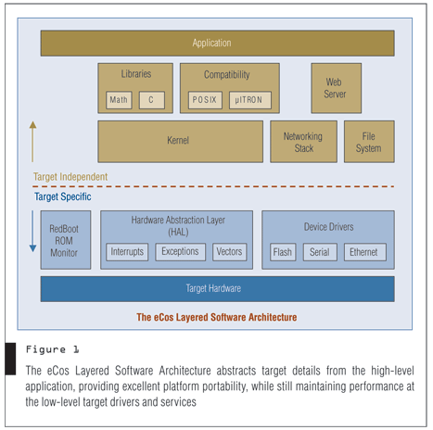
eCos ( Contd …)
http://www.cotsjournalonline.com/home/article.php?id=100164

Slide 67
FreeRTOS
Simple , Portable , Royalty free , Concise
Cross development from a standard Windows host
Choices of different scheduling policies
Pre-emptive: Always runs the highest available task. Tasks of identical priority share CPU time (fully pre-emptive with round robin time slicing).
Cooperative: Context switches only occur if a task blocks, or explicitly calls taskYIELD().
Notes:
Mini Realtime Kernel
Message Queue

Slide 68
FreeRTOS ( Contd )
Supports 8, 16 and 32bit microcontrollers including ARM7, AVR, 8051, MSP430 and x86.
Ports are available for the Philips ARM7, TI MSP430, Renesas (Hitachi) H8/S, Atmel AVR, Motorola/Freescale HCS12, Motorola/Freescale ColdFire, and others.
A smaller and easier real-time processing alternative for applications where larger RTOSes won't fit, like eCos and embedded Linux (or Real Time Linux).
Notes:
Majority of source code common to all supported development tools
RTOS kernel uses multiple priority lists

Slide 69
MicroC/OS
Highly portable, ROMable, very scalable, preemptive real-time, multitasking kernel
Has ports for most popular processors and boards in the market
Suitable for use in safety critical embedded systems such as aviation, medical systems and nuclear installations
Approved for use in DO-178B aerospace systems
Notes:
MicroC/OS has been designed as a small footprint real time pre-emptive OS that was designed for embedded use on 8 bit platforms upwardsOver 100 microprocessors are supported
Also known as µC/OS II or uC/OSII

Slide 70
MicroC/OS ( Contd )
kernel is preemptive real time, managing up to 64 tasks, with up to 56 tasks for application tasks
Each task has a unique priority and its own stack
Round robin scheduling between same-priority tasks is not supported
Memory management is performed using fixed size partitions.
Notes:
µC/OS II features
reentrant functions and is portable to different processors
operating system uses semaphores to restrict access to resources shared by multiple elements of the system

Slide 71
MicroC/OS ( Contd )
Each thread (task) is an infinite loop and can be in any one of the following 5 states
Dormant, Ready, Running, Waiting, ISR
IPC services include mailboxes, queues, and semaphores
Notes:
µC/OS II is a multitasking operating system

Slide 72
Other RTOS
* Opensource * Commercial
* Nut/OS * BeOS * µnOS
* TRON Project * ChorusOS * RMX
* MicroC/OS-II * RSX-11
* OS-9 * RT-11
* OSEKtime * RTOS-UH
* pSOS * VRTX

